Slide 1

Easy 3D
WE PUT THE EASY IN 3D, SO YOU CAN FOCUS ON CREATING, NOT CALIBRATING.
Nathan Pugh, Founder & CEO -
I founded Easy 3D because I saw too many creators, students, hobbyists, entrepreneurs get discouraged by how complicated and expensive 3D printing could be.
Easy
3D

Slide 2
PROBLEM
3D printing technology is powerful but expensive and hard to manage. Many individuals and small teams are discouraged by the cost of buying a printer and the steep learning curve of setup, calibration, and maintenance.
Easy
3D

Slide 3
THE SOLUTION
What we Offer:
Upload to Print: Customers upload 3D files or submit an idea
Custom Design Requests: CAD/design support for customers without 3D files
Fast Turnaround: Orders processed and shipped in 1–2 weeks
Our mission is to empower creators, makers, and businesses to bring their ideas to life through high-quality 3D printing services eliminating the barriers of traditional manufacturing with fast turnaround and tailored solutions.
Easy
3D

Slide 4
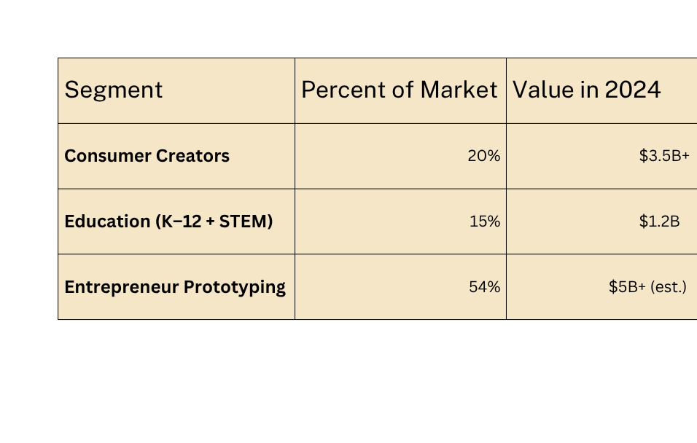
MARKET OPPURTUNITY
$21 Billion market size in 2024
Projected to grow to $57 Billion by 2029
CAGR: 22–24%, one of the fastest-growing tech sector
- https://www.marketsandmarkets.com/Market-Reports/3d-printing-market-1276.html
Easy
3D

Slide 5
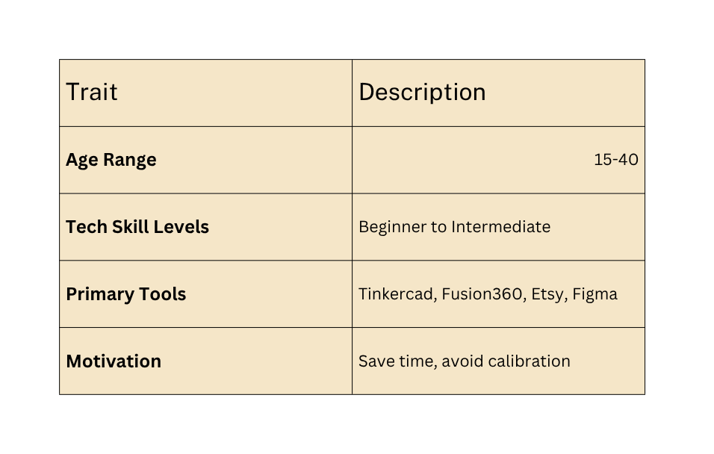
TARGET MARKET
Hobbyists & Creators
DIY makers, Etsy sellers, artists
Need: Fast, affordable custom prints
2. Entrepreneurs & Startups
Inventors, product designers
Need: Low-volume prototyping without setup costs
3. Designers Without Printers
3D artists, architects, engineers
Need: Physical models from digital files
Easy
3D

Slide 6
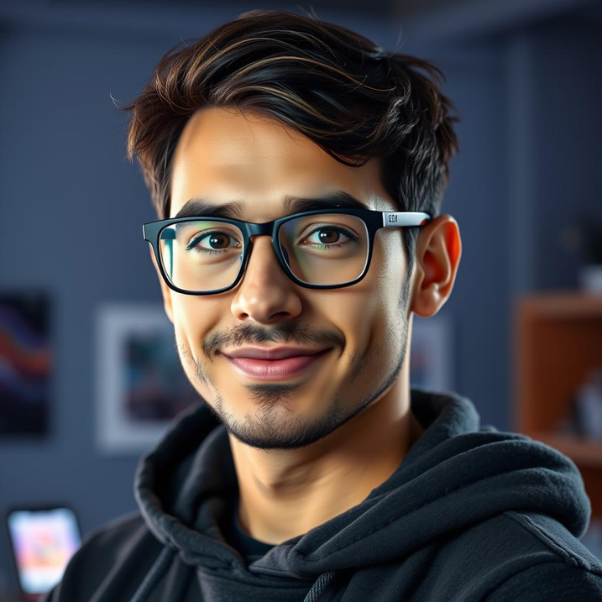
MEET - ALEX CARTER
Age:
28
Location:
Ventura, California
Occupation/Education Level:
Software Developer with an interest in DIY and 3D modeling, graduated with in BA in Software Engineering from California State University Channel Islands
Easy
3D

Slide 7
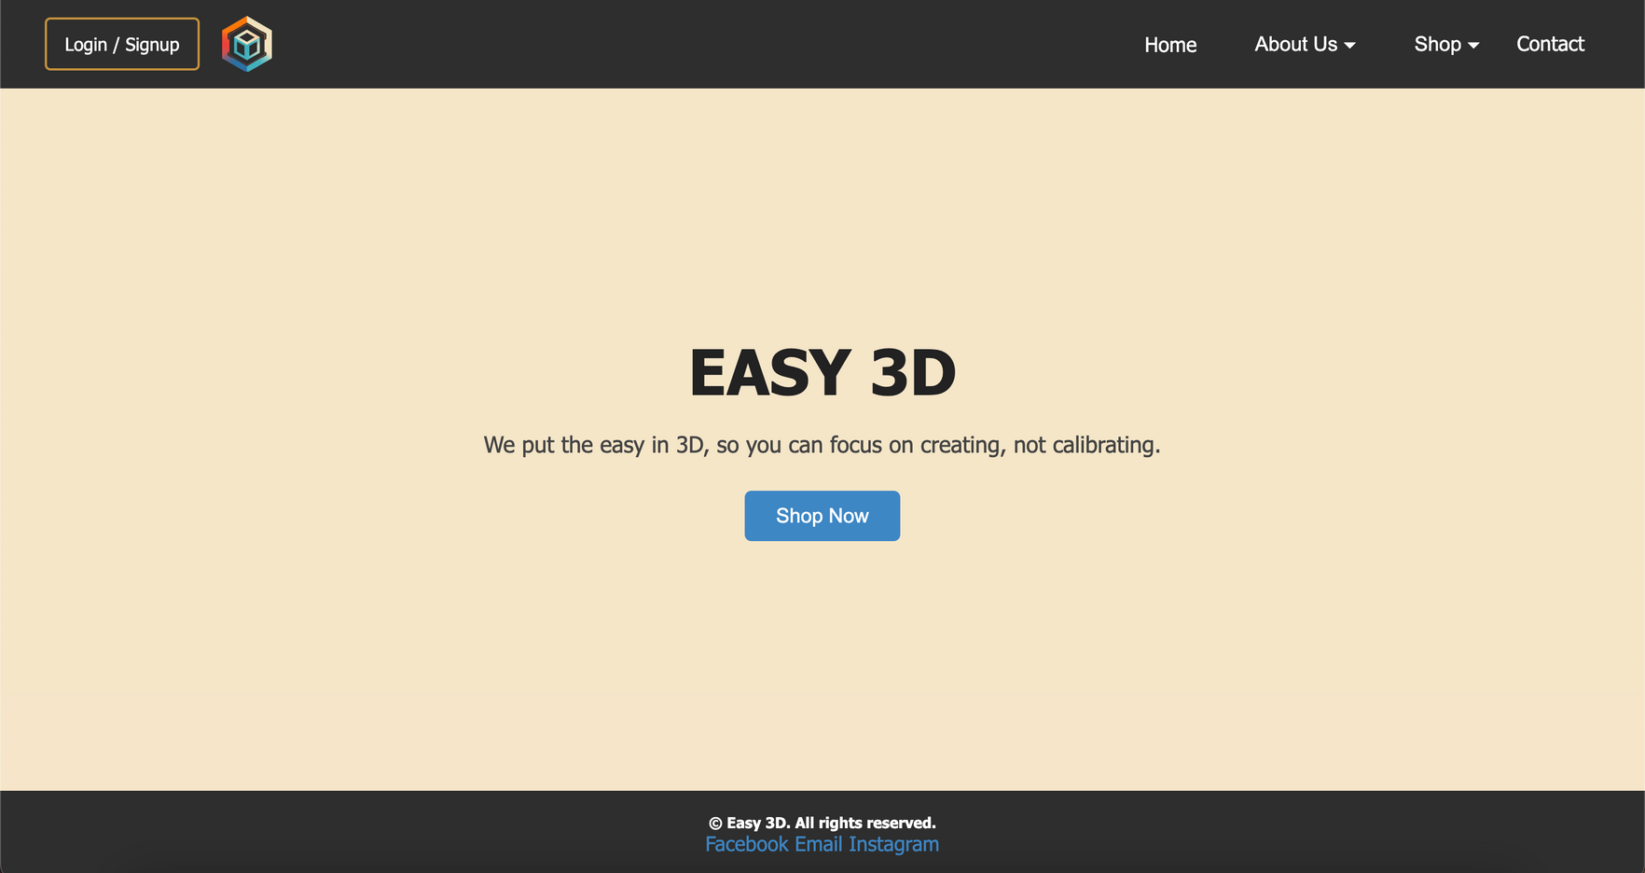
OUR WEBSITE
Easy
3D

Slide 8
PRICING MODEL
Custom Design Services
Custom Design Services:
Upload a sketch, idea, or file
We create the 3D model
Starting at $15/model
Ideal for entrepreneurs and small businesses
Subscriptions
Subscriptions:
Starter Pack: 5 prints/month – $25
Prototype Pack: 10 prints/month – $45
Includes priority printing + file repair support
Per Print:
Per Print
Based on material used (PLA, ABS, PETG, TPU, ect...) size, and complexity of the print
Great for hobbyists and first-time users

Slide 9
SUBSCRIPTIONS
Maker Lite – $9/month
Prototyper Pro
1 free print per month (up to 2in x 2in)
10% off all standard products
Access to monthly featured design file
Priority email support
Creator Plus – $19/month
2 free prints/month (up to 3in x 3in)
15% off all products & custom orders
Access to model review + file prep assistance
Quarterly surprise bonus (keychain, filament swatch, etc.)
Faster support via Discord or email
Creator Plus
Prototyper Pro – $39/month
4 free prints/month (up to 4in x 4in)
20% off sitewide + bulk print discounts
Priority production queue
1-on-1 custom consult per month
Free reprint insurance on failed files
Free shipping on all orders
Maker Lite

Slide 10
PRODUCT OVERVIEW
Some of our per print items are:
Keychain Charm - Custom keychain charms with a 2D version of the Easy 3D logo
Cable Holders - Keeps wires tidy
Phone Stands - Holds your phone upright on a desk or any flat surface
Bag Clips - Snap on clips for food bags
Bookmarks - Custom bookmarks with a 2D version of the Easy 3D logo left in void
Coasters - Flat surface with the Easy 3D logo embedded on its underside
Mini Planters - Tiny plant holders for succulents
Tool Holders - For organizing small tools or pens
Dice - Basic 6 sided die
Whistles - Simple mechanical objects that make sound when blown into
Easy
3D

Slide 11
INVESTMENT OPPURTUNITY
Idea & Planning
Company Launch
Traction & Growth
Product Expansion
Scaling Up
May 2025
October 2025
December 2025
2026 - 2030
2030+
Identified market need for accessible 3D printing
Developed concept and early branding
We are requesting $500–$1,500
Website live
First featured products added
Initial marketing to early adopters
We are requesting $2,000–$5,000
Hope to have achieved:
50+ subscribers
$500 raised from early customers
Built custom design intake process
We are requesting $5,000–$15,000
Launched custom design service
Added 5+ new featured items
Began prototyping education kits
We are requesting $15,000–$40,000
Preparing subscription model
Targeting school contracts
Enhancing fulfillment workflow
We are requesting $50,000–$150,000+
Easy
3D

Slide 12
OUR TEAM
Nathan Pugh – Founder & CEO:
Built Easy 3D from idea to launch
Manages product development, customer experience, and operations
Passionate about making 3D printing accessible to creators, students, and entrepreneurs
Easy
3D

Slide 13
Easy 3D
THANKS YOU FOR LISTENING
DONT LET FEAR LIMIT YOUR CREATIVITY
Nathan Pugh, Founder & CEO
31 June, 2025
Easy
3D

